Slide 1
TREE

Slide 2

Nature lover’s view of a tree
leaves
branches
root
root

Slide 3
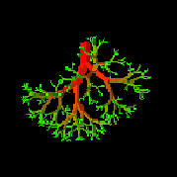
Computer Scientist’s View
root
leaves
branches
nodes

Slide 4
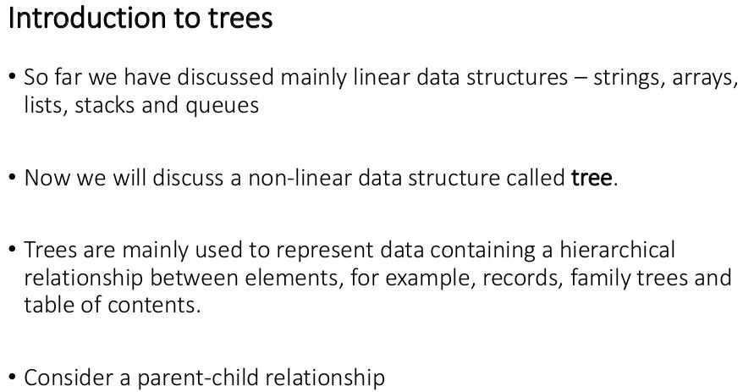

Slide 5
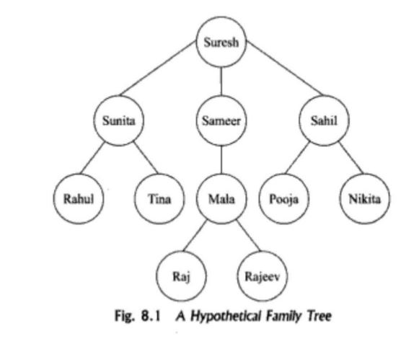

Slide 6
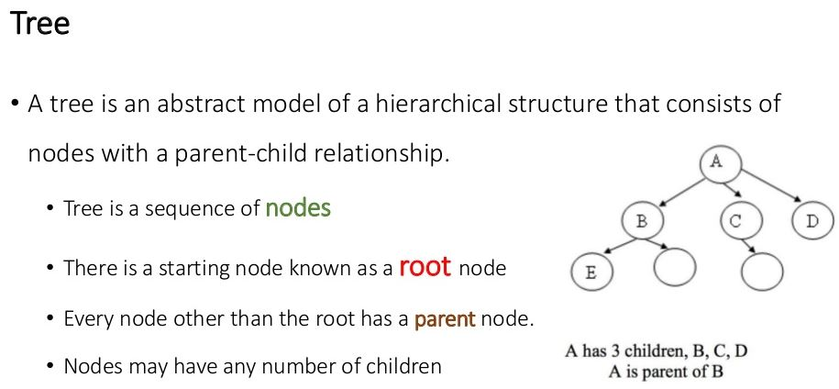

Slide 7
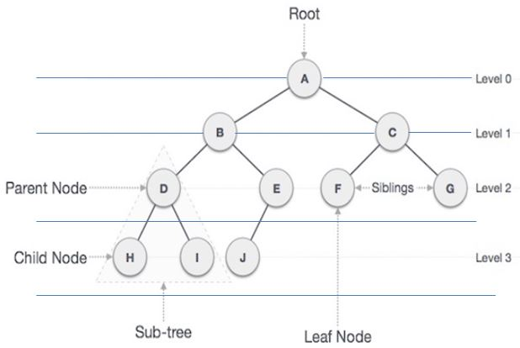
Fig:1 Example of tree

Slide 8
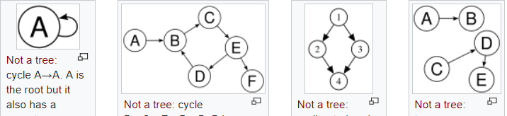
cycle
These figures are not a tree it is graph because there exist loop or cycle.

Slide 9
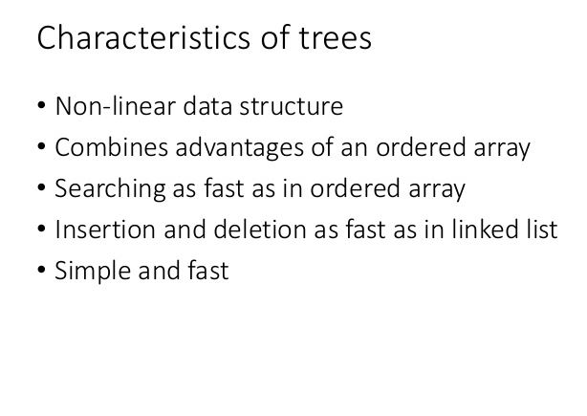

Slide 10
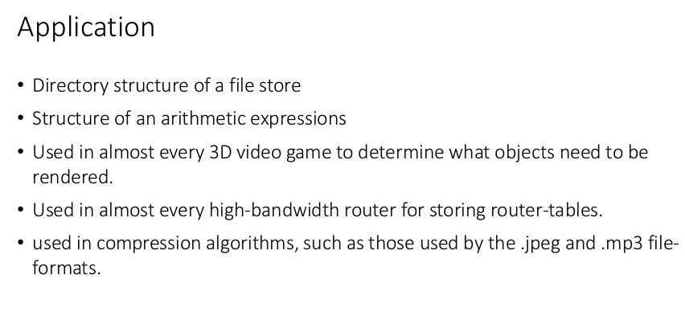

Slide 11
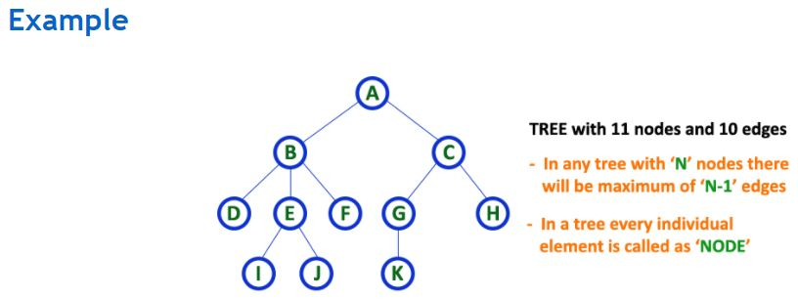

Slide 12
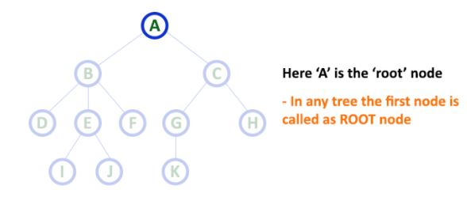
Tree Terminology:
In a tree data structure we use following terminology…
Root

Slide 13
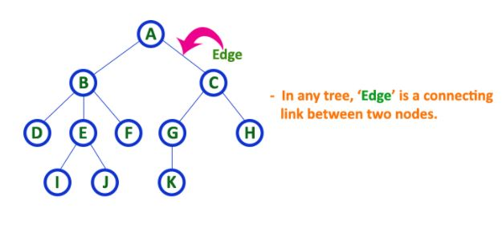
2. Edge

Slide 14
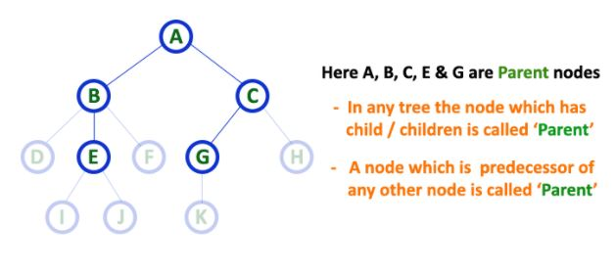
3. Parent

Slide 15
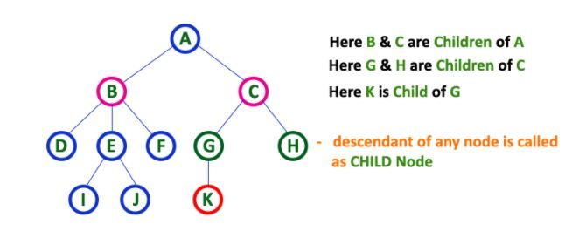
4. Child

Slide 16
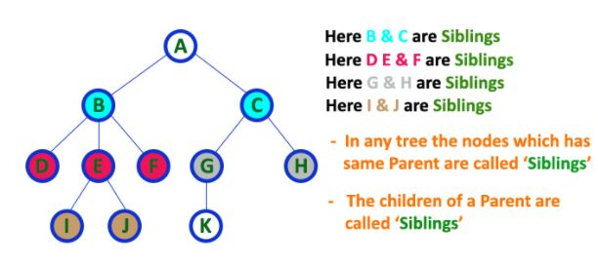
5. Sibling

Slide 17
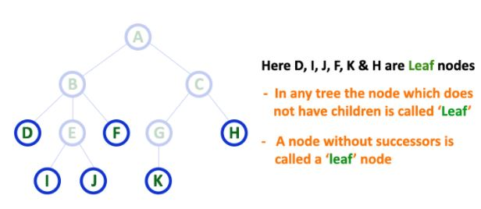
6. Leaf

Slide 18
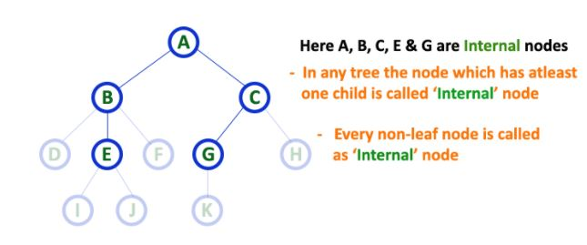
7. Internal node

Slide 19
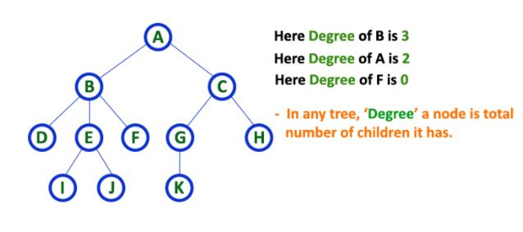
8. Degree

Slide 20
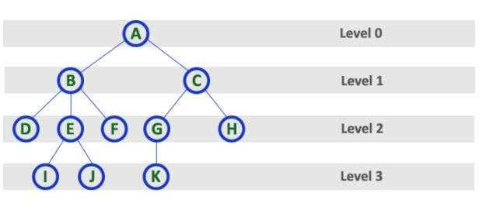
9. Level

Slide 21
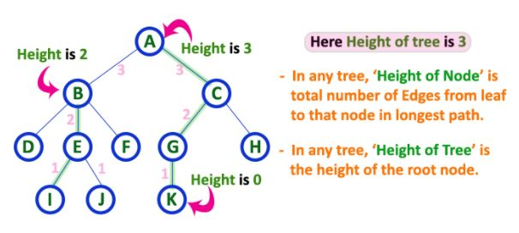
10. Height

Slide 22
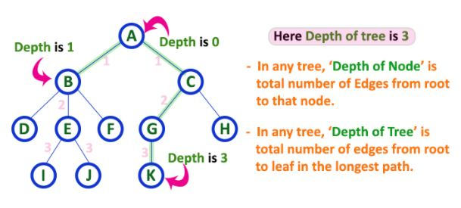
11. Depth

Slide 23
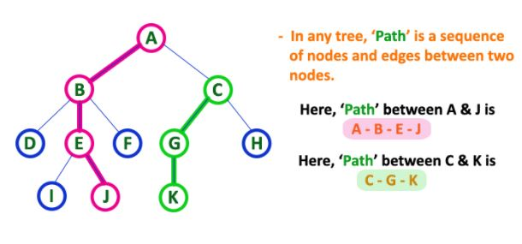
12. Path

Slide 24
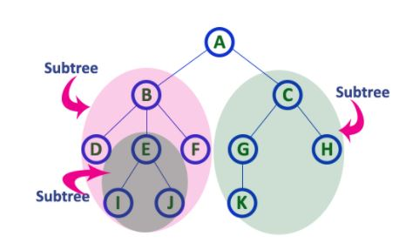
13. Sub Tree

Slide 25
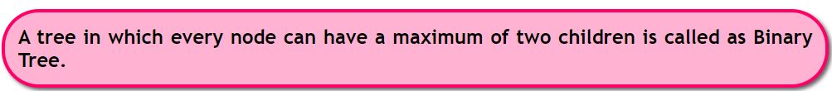
Binary Tree
In a normal tree, every node can have any number of children.
Binary tree is a special type of tree data structure in which every node can have a maximum of 2 children. One is known as left child and the other is known as right child.
In a binary tree, every node can have either 0 children or 1 child or 2 children but not more than 2 children.

Slide 26

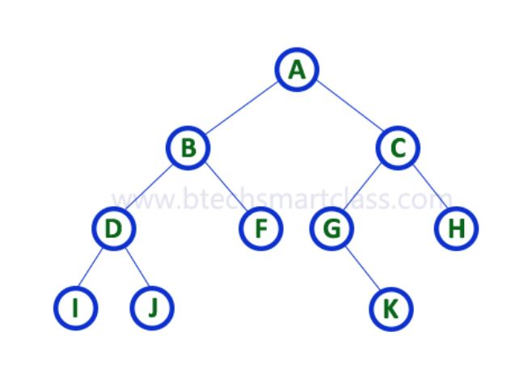
Fig: Binary Tree

Slide 27
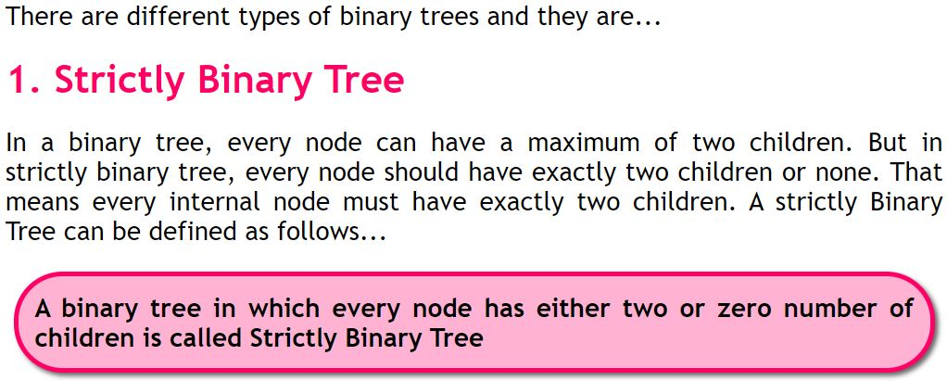

Slide 28
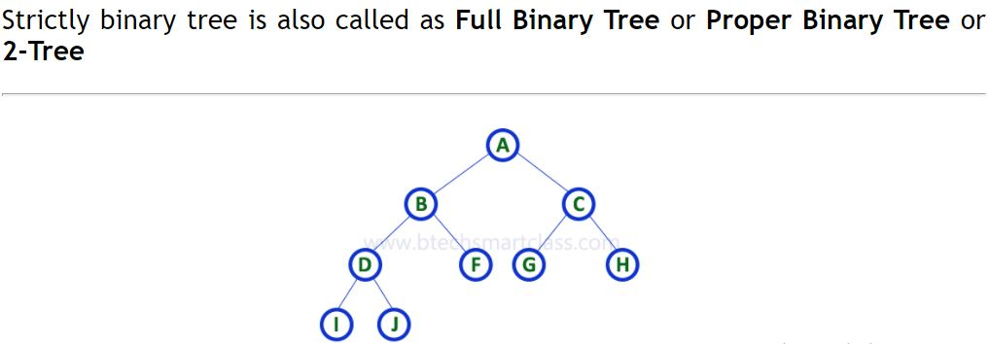
Fig: Strictly Binary Tree

Slide 29
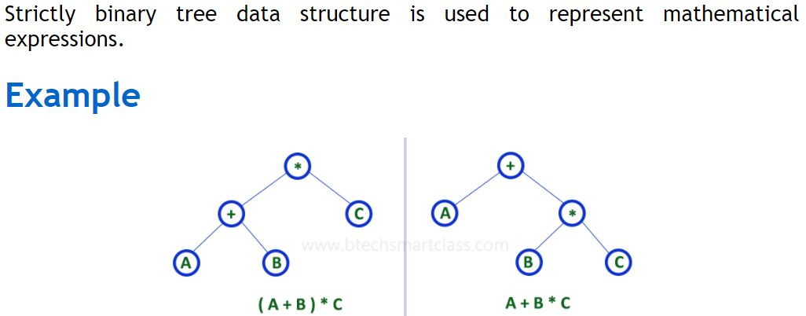

Slide 30
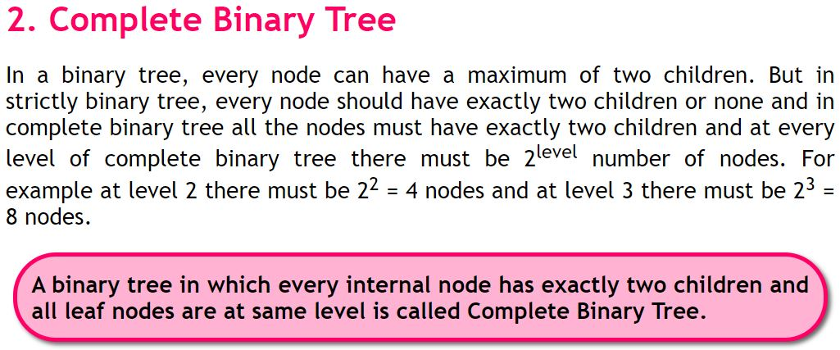

Slide 31
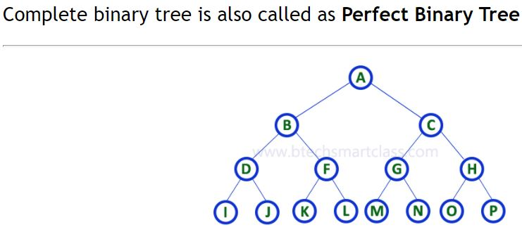
Fig: Complete Binary Tree

Slide 32
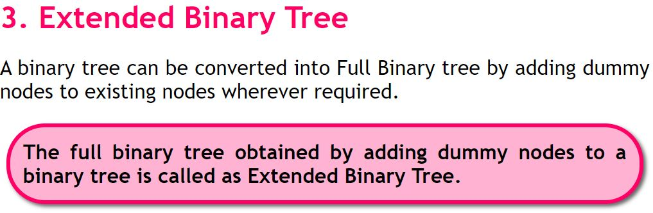
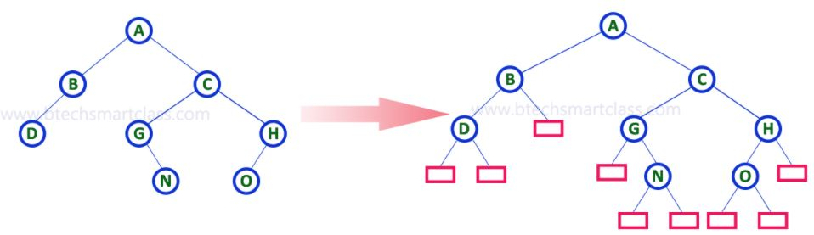
Fig: Extended Binary Tree
by adding dummy nodes.

Slide 33
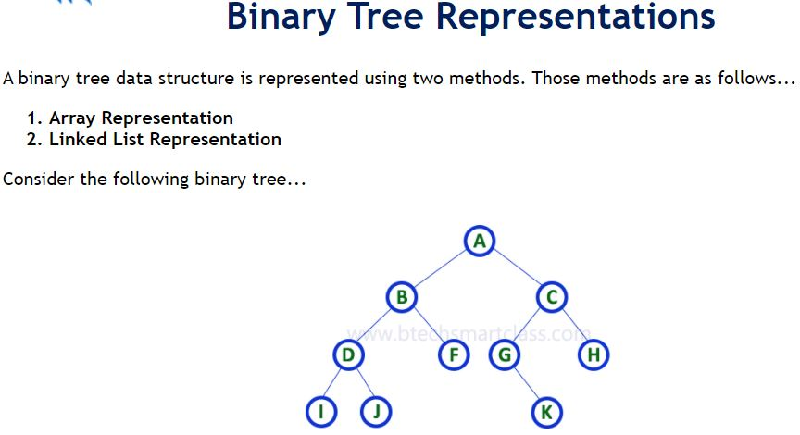
Fig: Binary Tree

Slide 34
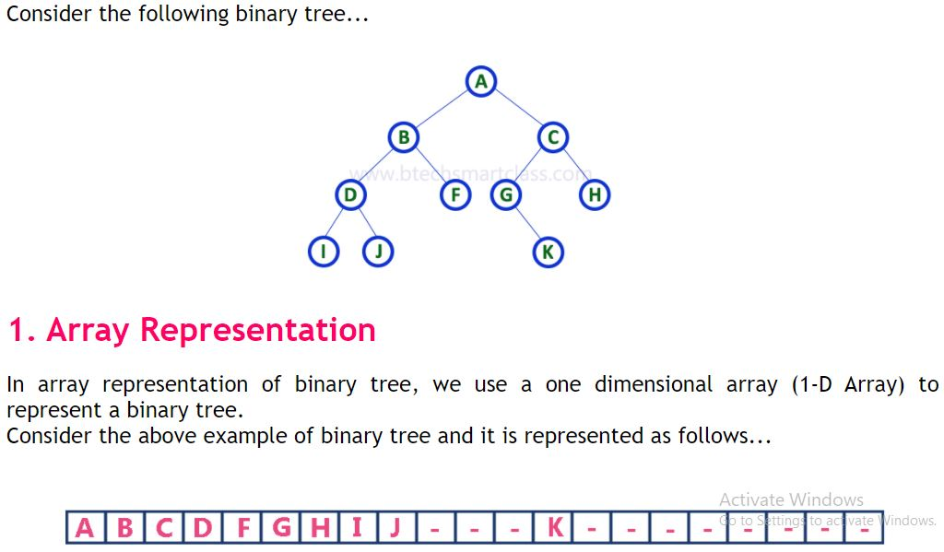

Slide 35
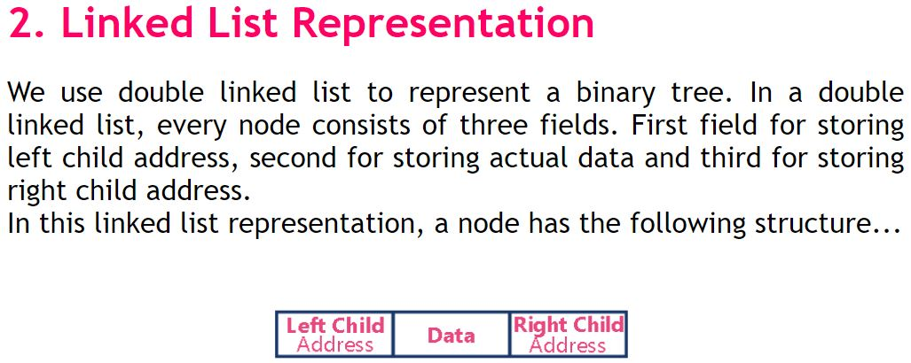

Slide 36
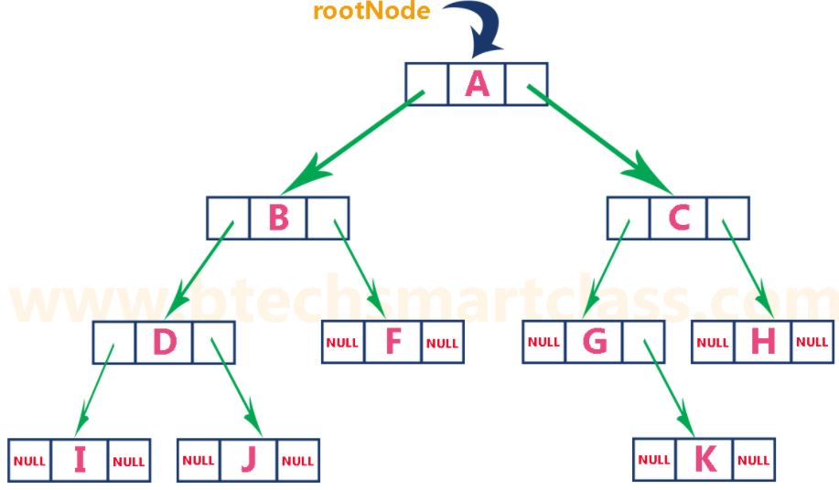

Slide 37
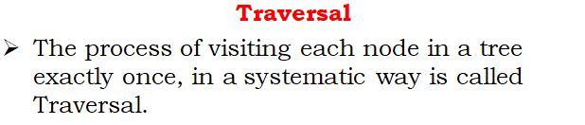
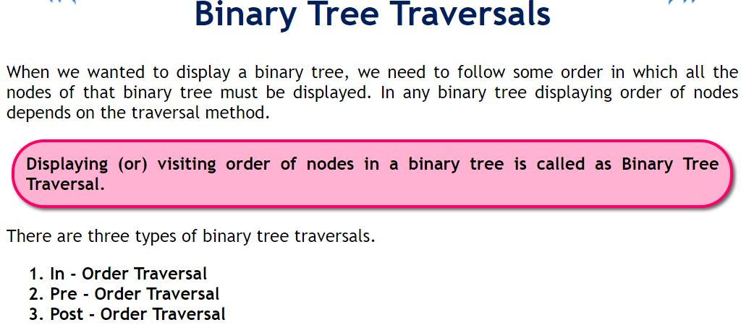

Slide 38
1. In - Order Traversal ( leftChild - root - rightChild )
In In-Order traversal, the root node is visited between left child and right child. In this traversal, the left child node is visited first, then the root node is visited and later we go for visiting right child node.
2. Pre - Order Traversal ( root - leftChild - rightChild )
In Pre-Order traversal, the root node is visited before left child and right child nodes. In this traversal, the root node is visited first, then its left child and later its right child.
3. Post - Order Traversal ( leftChild - rightChild - root )
In Post-Order traversal, the root node is visited after left child and right child. In this traversal, left child node is visited first, then its right child and then its root node.

Slide 39
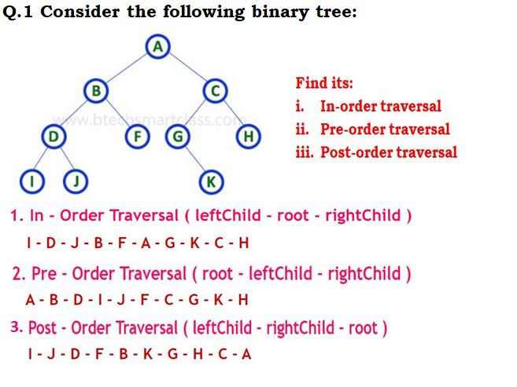

Slide 40
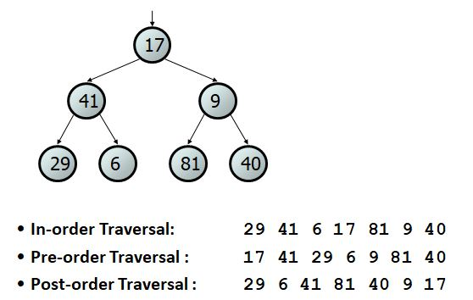
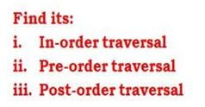
Q.2 Consider the following binary tree:

Slide 41
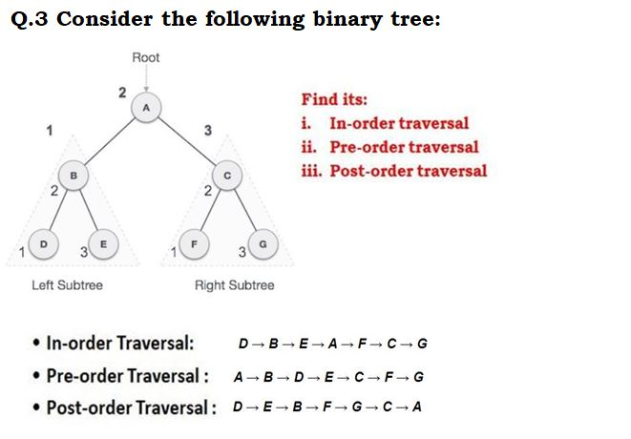

Slide 42
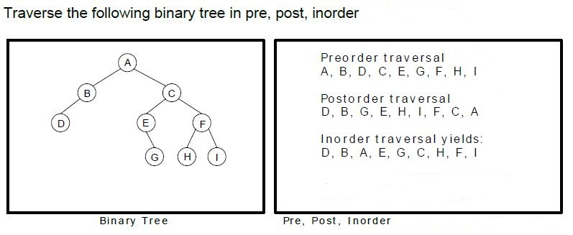
Q.4

Slide 43
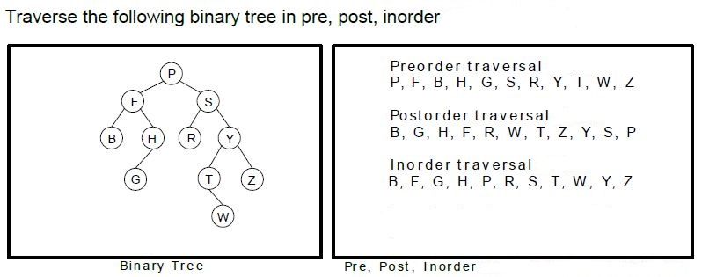
Q.5

Slide 44
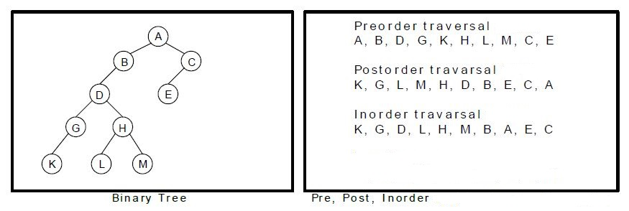
Q.6 Traverse the following binary tree in pre, post, inorder.

Slide 45
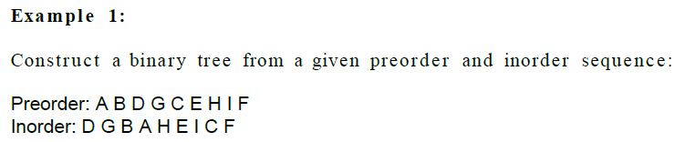
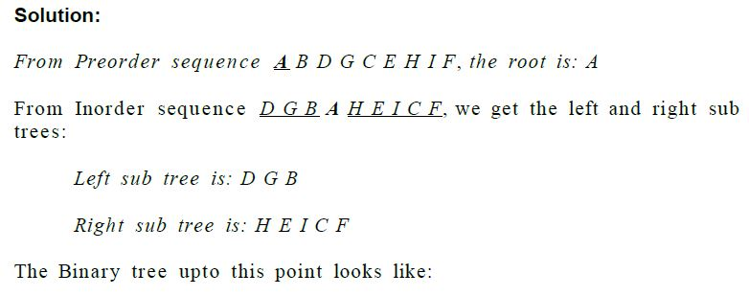
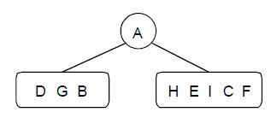

Slide 46
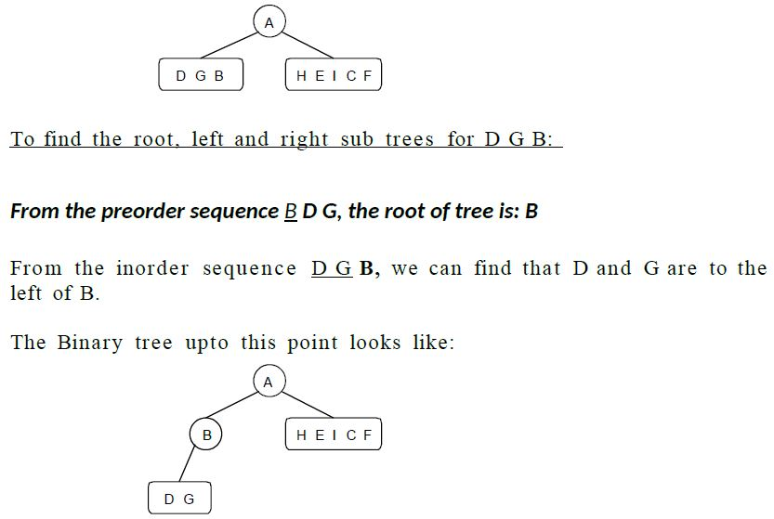


Slide 47
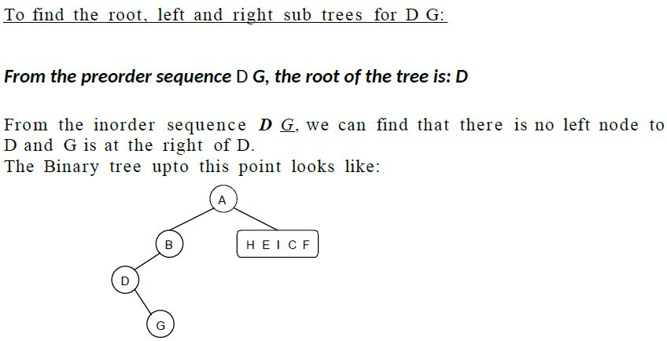

Slide 48
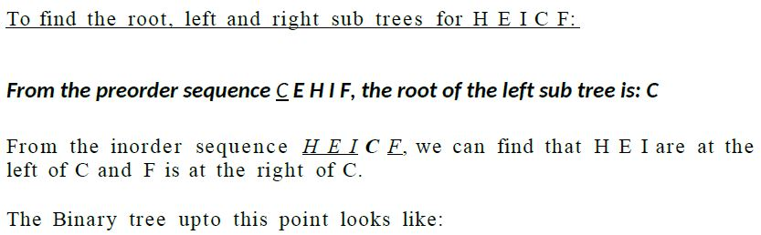


Slide 49


Fig: Binary Tree

Slide 50



Slide 51




Slide 52


Slide 53


Slide 54



Slide 55




Do this questions:
Pre-order
In-order

Slide 56



In-order
Post-order

Slide 57


Slide 58

A binary search tree should satisfies the following condition:
All the node in left sub tree of a node ‘N’ are less than the content of N.
All the node in right sub tree of a node ‘N’ are greater than or equal to the content of N.
Both the left and right sub tree of the node must be binary search tree.

Slide 59

Example:

Slide 60


Fig: Binary Search Tree

Slide 61


Slide 62


Slide 63


Slide 64




Question 1: Construct a Binary Search Tree by inserting the following sequence of numbers…
Step:1
Step:2
Step:3

Slide 65


Step:4
Step:5

Slide 66


Step:6
Step:7

Slide 67


Step:8
Step:9

Slide 68



Question 2: Draw the binary search tree (BST) for the following sequence of data:
8,18,5,15,17,25,40,80
Step:1
Insert (8)
Step:2
Insert (18)
Step:3
Insert (5)

Slide 69


Step:4
Insert (15)
Step:5
Insert (17)

Slide 70

Step:6
Insert (25)
Step:7
Insert (40)
25
40

Slide 71

Step:8
Insert (80)
80

Slide 72
Question 3: Draw the binary search tree (BST) for the following sequence of data:
10, 30, 50, 40, 60, 100, 5, 2
Question 4: Construct a Binary Search Tree by inserting the following sequence of numbers...
14, 15, 4, 9, 7, 18, 3, 5, 16, 4, 20, 17, 9, 14, 5
Question 5: Construct a Binary Search Tree by inserting the following sequence of numbers…
25, 20, 36, 10, 22, 30, 40, 28, 38, 48, 45, 50, 12, 15, 5

Slide 73

AVL Tree:

Slide 74


Slide 75


Slide 76


Slide 77


Slide 78


Slide 79


Slide 80

There are four rotations and they are classified into two types:

Slide 81

Rule:
Right of Right: (Rotate-Left or Left Rotation)
To understand Left Rotation, Let us consider the following insertion operations into an AVL Tree…
Rotate-left
Right of Right

Slide 82

2. Left of Left: (Rotate-Right or Right Rotation)
To understand Right Rotation, Let us consider the following insertion operations into an AVL Tree…
Rotate-Right
Left of Left

Slide 83

3. Left of Right (Left Right Rotation):
Rotate Left
Rotate Right
To understand Left Right Rotation, Let us consider the following insertion operations into an AVL Tree…
a. Rotate-Left
b. Rotate-Right
Left of Right

Slide 84

4. Right of Left (Right Left Rotation):
Rotate Right
Rotate Left
To understand Right Left Rotation, Let us consider the following insertion operations into an AVL Tree…
a. Rotate-Right
b. Rotate-Left
Right of Left

Slide 85


Slide 86


Slide 87


Slide 88

Step:1
Step:2

Slide 89

Step:3
Rotate Left
Right of Right

Slide 90

Step:4

Slide 91

Step:5
Rotate Left
Right of Right
( Take 3,4,5)

Slide 92

Step:6
Rotate Left
Right of Right
( Take 2,4,5 because 5 still have child)

Slide 93

Step:7
Rotate Left
Right of Right
( Take 5,6,7)

Slide 94

Step:8
Fig: Final AVL Tree

Slide 95


Example:2
0-0=0

Slide 96

1-0=1
0-0=0

Slide 97

1-1=0
0-0=0
0-0=0

Slide 98

2-1=1
1-0=1
0-0=0
0-0=0

Slide 99

3-1=2
2-0=2
0-0=0
1-0=1
0-0=0

Slide 100


Slide 101

2-1=1
1-1=0
0-0=0
Rotate Right
0-0=0
0-0=0
Left of Left

Slide 102


3-1=-2
1-2=-1
0
Left of Right
0
1-0=1
0
Tree is imbalanced. i.e in node 50, 10, 20 (Left of Right). So
Rotate left
Rotate right

Slide 103


Rotate left

Slide 104

2-2=0
1-1=0
1-1=0
0-0=0
0-0=0
0-0=0
0-0=0

Slide 105


2-3=-1
1-1=0
2-1=1
0-0=0
0-1=-1
0-0=0
0-0=0
0-0=0

Slide 106


3-3=0
1-2=-1
2-1=1
0-0=0
0-1=-1
0-0=0
1-0=1
0-0=0
0-0=0

Slide 107


3-4=-1
1-2=-1
3-1=2
0-2=-2
0
1-0=1
0
0
0-1=-1
Right of Right
Rotate Left
0

Slide 108

0
-1
1
0
1
0
0
0
0
0

Slide 109
Question 3: Construct a AVL Tree by inserting the following sequence of numbers...
14, 15, 4, 9, 7, 18, 3, 5, 16, 4, 20, 17, 9, 14, 5

Slide 110
Solution:
Step-1: Insert 14
0-0=0
14
Tree is balanced

Slide 111
Step-2: Insert 15
0-1=-1
14
15
0-0=0
Tree is balanced

Slide 112
Step-3: Insert 4
1-1=0
14
0-0=0
4
15
0-0=0
Tree is balanced

Slide 113
Step-4: Insert 9
2-1=1
14
0-1=-1
4
15
0-0=0
9
0-0=0
Tree is balanced

Slide 114
Step-5: Insert 7
3-1=2
14
0-0=0
0-2=-2
4
15
9
1-0=1
7
Tree is imbalance i.e in node 4,9,7. (Right of left)
a. Rotate Right
b. Rotation left
a. Rotate Right
0-0=0
Tree is Imbalanced

Slide 115
2-1=1
14
0-0=0
0-2=-2
4
15
7
0-1=-1
9
b. Rotation left
0-0=0
Tree is Imbalanced

Slide 116
2-1=1
1-1=0
14
7
15
0-0=0
4
9
0-0=0
0-0=0
Tree is balanced

Slide 117
Step-6: Insert 18
2-2=0
14
0-1=-1
1-1=0
7
15
4
9
18
0-0=0
0-0=0
0-0=0
Tree is balanced

Slide 118
Step-7: Insert 3
3-2=1
14
2-1=1
0-1=-1
7
15
1-0=1
4
9
18
3
0-0=0
0-0=0
0-0=0
Tree is balanced

Slide 119
Step-8: Insert 5
3-2=1
14
2-1=1
0-1=-1
7
15
1-1=0
4
9
18
0-0=0
0-0=0
3
5
0-0=0
0-0=0
Tree is balanced

Slide 120
Step-9: Insert 16
3-2=1
14
2-1=1
0-2=-2
7
15
1-1=0
1-0=1
4
9
18
3
0-0=0
5
16
0-0=0
a. Rotate Right
0-0=0
0-0=0
Tree is imbalance i.e in node 15,18,16. (Right of Left)
Rotate Right
Rotate Left
Tree is Imbalanced

Slide 121
3-2=1
14
0-2=-2
2-1=1
7
15
1-1=0
0-1=-1
4
9
16
3
5
0-0=0
18
0-0=0
0-0=0
0-0=0
b. Rotate left
Tree is Imbalanced

Slide 122
3-2=1
14
2-1=1
7
16
1-1=0
1-1=0
15
4
9
18
0-0=0
0-0=0
0-0=0
3
5
0-0=0
0-0=0
Tree is balanced

Slide 123
Step-10: Insert 4
3-2=1
14
3-1=2
7
16
1-1=0
a. Rotate left
0-0=0
1-2=-1
15
4
9
18
0-0=0
0-0=0
3
5
1-0=1
0-0=0
Tree is imbalance i.e in node 7,4,5. (Left of Right)
Rotate Left
Rotate Right
4
0-0=0
Tree is Imbalanced

Slide 124
3-2=1
14
3-1=2
7
16
1-1=0
b. Rotate Right
2-0=2
15
18
5
9
1-1=0
4
0-0=0
0-0=0
0-0=0
3
4
0-0=0
0-0=0
Tree is Imbalanced

Slide 125
3-2=1
14
2-2=0
5
16
1-1=0
1-1=0
4
0-1=-1
15
18
7
3
0-0=0
0-0=0
4
9
0-0=0
0-0=0
0-0=0
Tree is balanced

Slide 126
Step-11: Insert 20
3-3=0
14
2-2=0
5
16
1-2=-1
1-1=0
0-1=-1
4
0-1=-1
15
18
7
3
0-0=0
4
20
9
0-0=0
0-0=0
0-0=0
0-0=0
Tree is balanced

Slide 127
Step-12: Insert 17
3-3=0
14
2-2=0
1-2=-1
5
16
1-1=0
0-0=0
4
0-1=-1
15
18
7
3
0-0=0
4
17
20
9
0-0=0
0-0=0
0-0=0
0-0=0
0-0=0
Tree is balanced

Slide 128
Step-13: Insert 9
3-3=0
14
2-2=0
1-2=-1
5
16
1-1=0
0-2=-2
0-0=0
4
15
18
7
3
0-0=0
4
0-1=-1
17
20
9
0-0=0
0-0=0
0-0=0
0-0=0
9
a. Rotate Left
Tree is imbalance i.e in node 7,9,9. (Right of Right)
a. Rotate Left
0-0=0
Tree is Imbalanced

Slide 129
3-3=0
14
2-2=0
1-2=-1
5
16
1-1=0
1-1=0
0-0=0
4
15
18
9
3
7
0-0=0
4
17
20
9
0-0=0
0-0=0
0-0=0
0-0=0
0-0=0
0-0=0
Tree is balanced

Slide 130
Step-14: Insert 14
3-3=0
14
2-2=0
5
16
2-2=0
1-1=0
1-1=0
1-0=1
0-0=0
4
15
18
9
3
7
4
14
17
20
9
0-0=0
0-0=0
0-0=0
0-0=0
0-0=0
0-0=0
0-0=0
Tree is balanced

Slide 131
Step-15: Insert 5
4-3=1
14
2-2=0
2-3=-1
5
16
2-1=1
1-0=1
1-1=0
15
0-0=0
4
9
18
3
7
4
14
17
20
0-0=0
9
0-0=0
1-0=1
0-0=0
0-0=0
0-0=0
0-0=0
5
0-0=0
Tree is balanced
Final AVL Tree

Slide 132
Question 4: Draw the AVL Tree for the following sequence of data:
10, 30, 50, 40, 60, 100, 5, 2
Question 5: Construct a AVL Tree by inserting the following sequence of numbers…
25, 20, 36, 10, 22, 30, 40

Slide 133


Slide 134
Application of Tree
Searching
Sorting
Compiler (to validate the syntax, it uses syntax tree)
Routers (store routing information)
Database design
File system
Shortest path among the networks (minimum spanning tree)
Organization chart
Machine learning
Encryption
Block chain
Gaming
Coding

